Slide 1
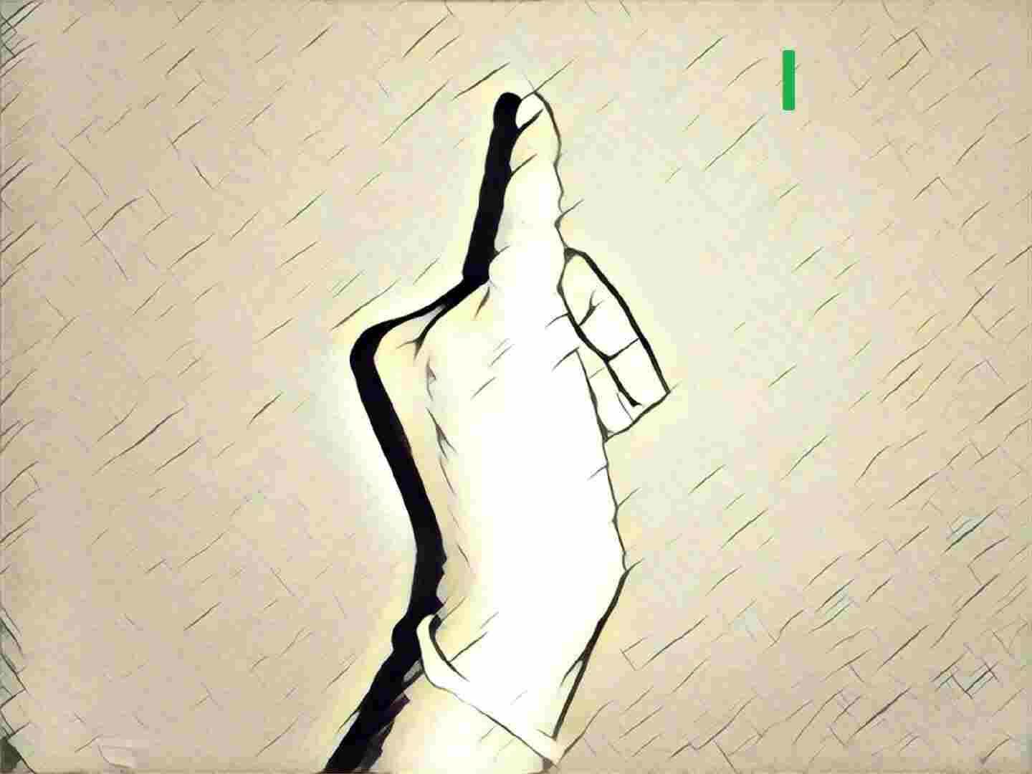
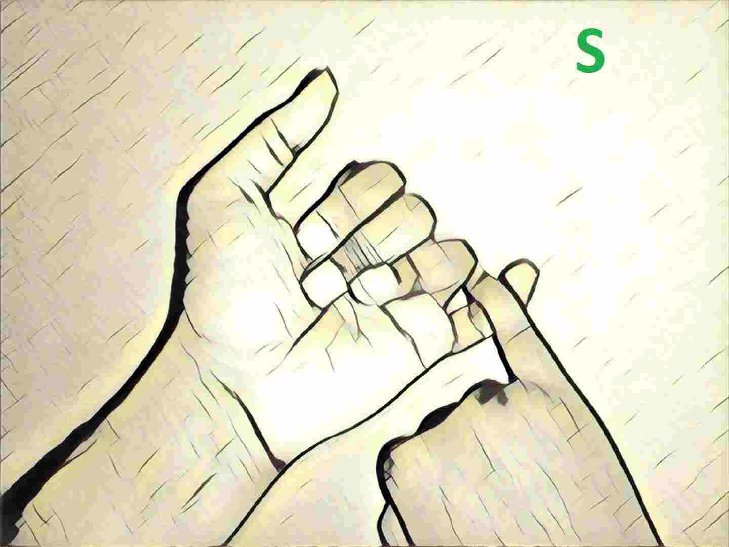
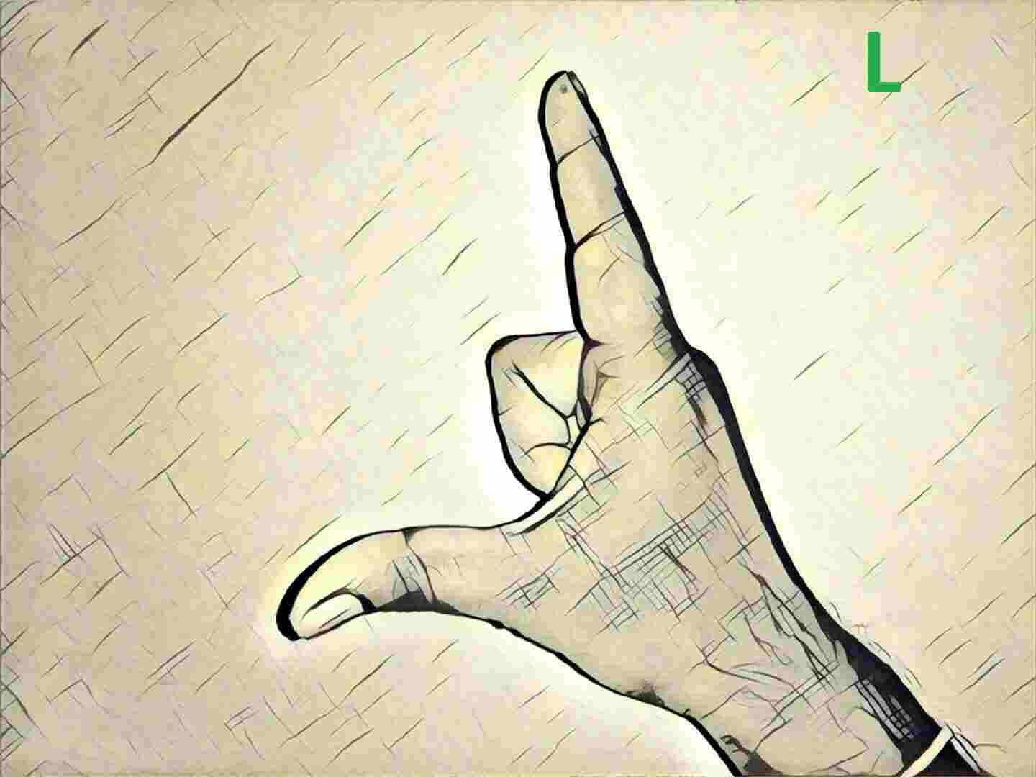
INTERPRETER
Team Members:
Akshay Nimbalkar
Harish Fegade
Raviraj Dixit
Sangeeth Kumar

Slide 2
Problem Statement
The main objective of our project is to translate sign language to speech.
The aim is to provide a helping-hand for speech-impaired to communicate with rest of the world using sign language.
Everyone cannot have a personal interpreter for understanding the sign language, we intend to develop an app that every deaf as well as hearing person should have in order to interact with one another.

Slide 3
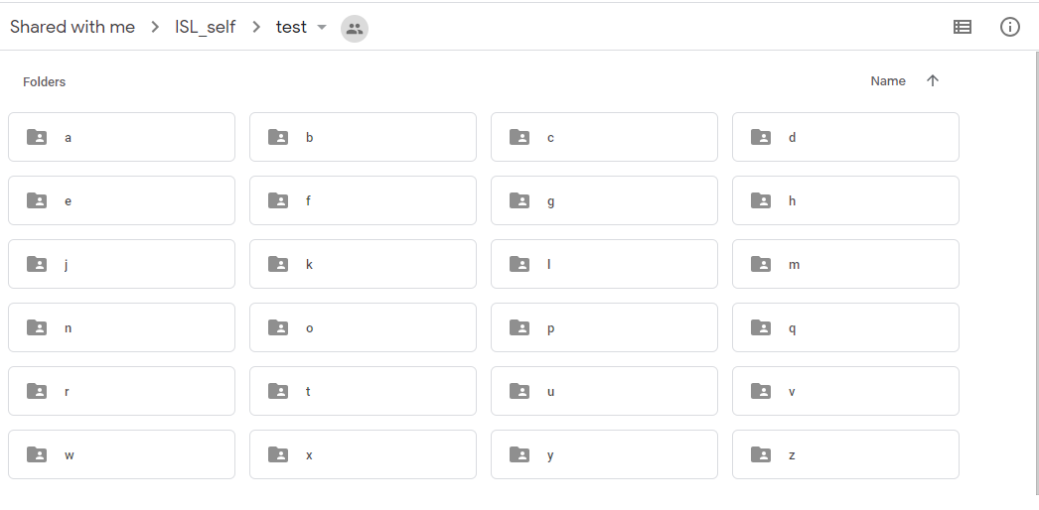
Data Collection
Images:
Dataset contains: > 110,000 images in train, test, validation
Images created from videos captured of students of deaf school.
ex . Hashu Advani College Of Special Education.

Slide 4
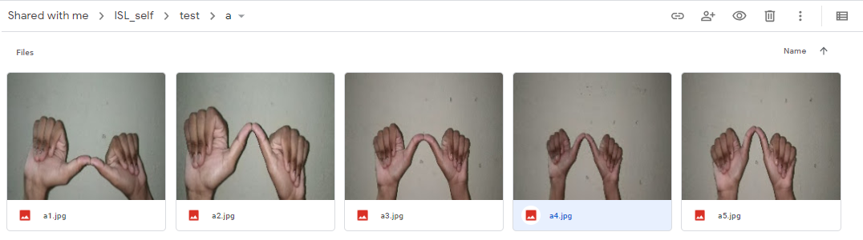
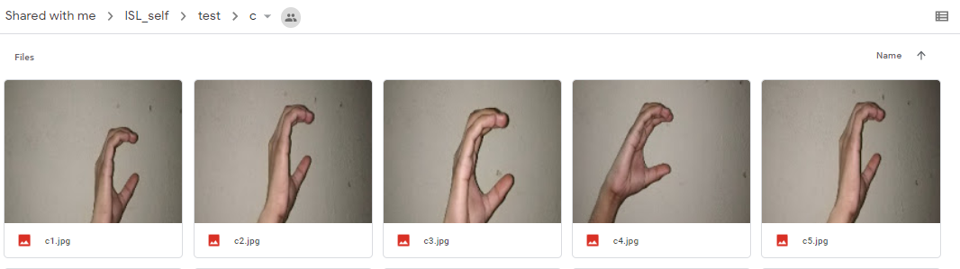

Slide 5
Workflow
Data Collection:
Videos to Images
Image Preprocessing:
Resize(224*224)
Augmentation
Model Building:
Transfer Learning with VGG16
Evaluation Metrics:
Accuracy and Loss function
Analysis:
Confusion Matrix of actual and predicated images

Slide 6
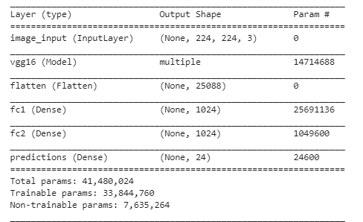
Model Summary

Slide 7
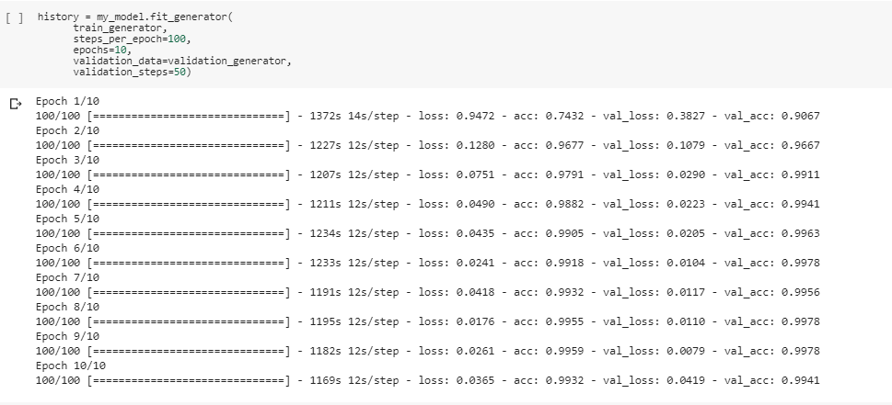
Model Accuracy and Validation Loss
Accuracy : 99.41
Loss : 0.041

Slide 8
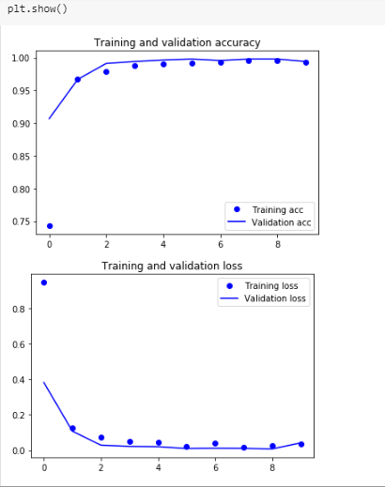
Model Accuracy and Validation Loss Plots:

Slide 9
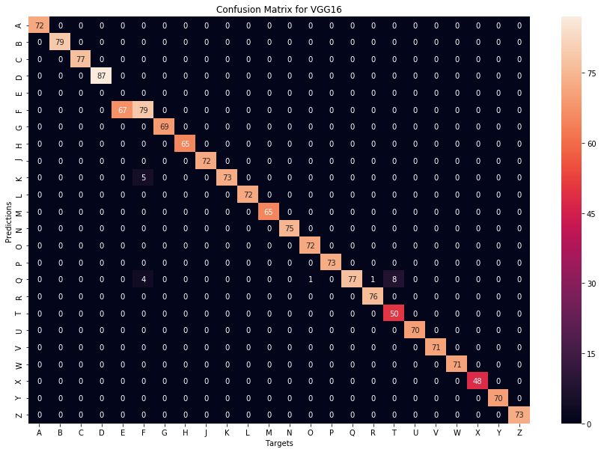
Confusion Matrix – Validation Set

Slide 10
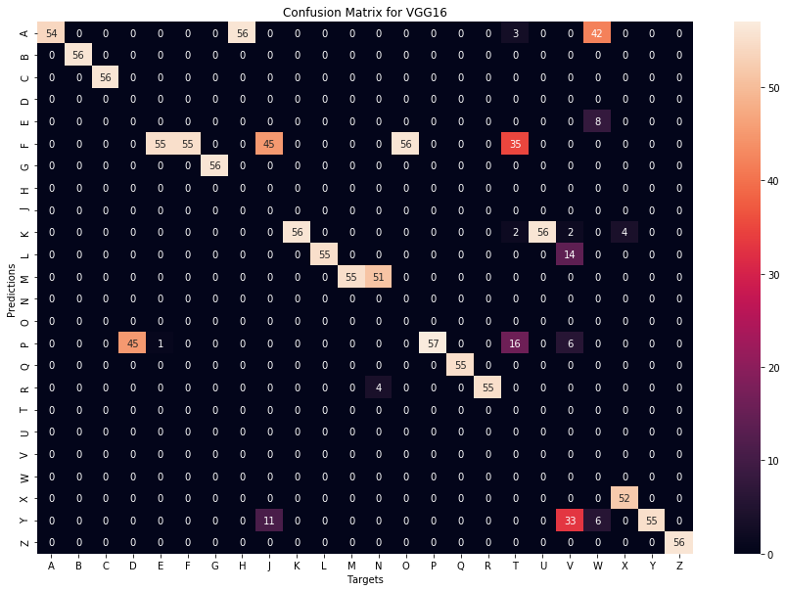
Confusion Matrix – test Set

Slide 11
Phase 2
Alphabets Recognition using webcam to generate words (Image to Text)
Text to Speech using api’s
Create an Android app using Tensorflow Lite

Slide 12
Challenges
Data availability
Model building & training
Execution of Deep Learning Model in Android platform.

Slide 13

Project Timelines
Milestones | Start date | Finish date | Grading
Define a problem | 10-03-2019 | 04-04-2019 | 5%
Get the Data | 25-03-2019 | 30-04-2019 | 5%
Explore and pre-process data | 25-03-2019 | 30-04-2019 | 10%
Create Features | 25-03-2019 | 30-04-2019 | 5%
Create Model | 04-04-2019 | 31-05-2019 | 15%
Deploy & consume model | 01-05-2019 | 31-05-2019 | 10%
Report Writing | 01-05-2019 | 10-06-2019 | 10%
Project submission | 13-06-2019 | 13-06-2019 | 15%
Final presentation with project/ product demonstration | 13-06-2019 | 13-06-2019 | 20%
Blog publishing | 10-06-2019 | 10-06-2019 | 5%

Slide 14
Thank You

